Slide 1
Battle of the Neighborhoods
Predicting Gentrification in Los Angeles
Ryan Belfer

Slide 2
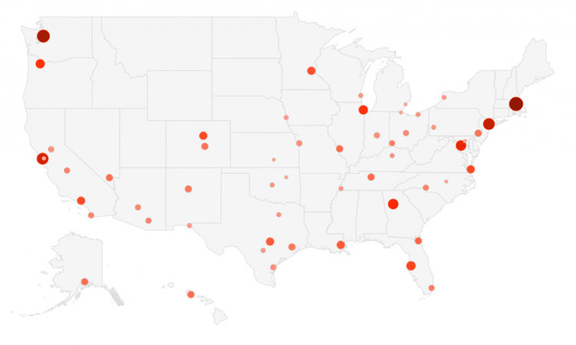
Introduction
Gentrification occurs across the country, improving low-income areas and raising value
Areas of gentrification increase property by over double = great investment
Predict gentrification of low-income areas by clustering with high-income areas
Map of gentrified cities by percentage of low-income gentrified. Los Angeles is one of the smaller dots, signifying it is not yet heavily gentrified.
Source: https://www.businessinsider.com/map-the-cities-with-the-most-gentrified-neighborhoods-2013-11

Slide 3
Data Sources
LA Almanac Median Income by ZIP Code Table for ZIP list and median income values
LA Times website for latitude and longitude values for ZIP codes
Foursquare API for venues based on latitude and longitude
U.S. Census Population Factfinder for population by ZIP
Statistical Atlas for population density by ZIP

Slide 4
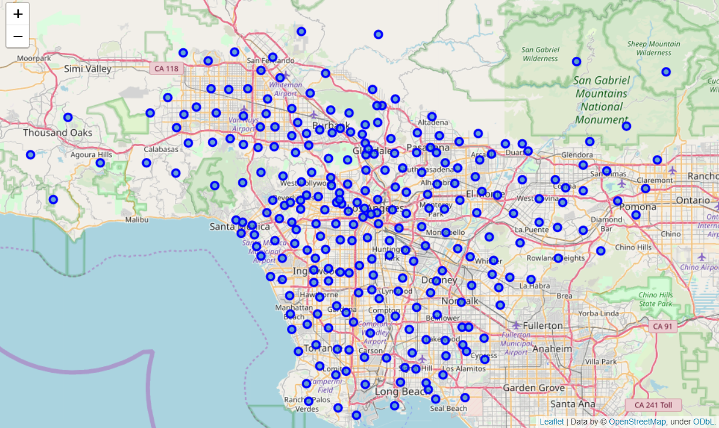
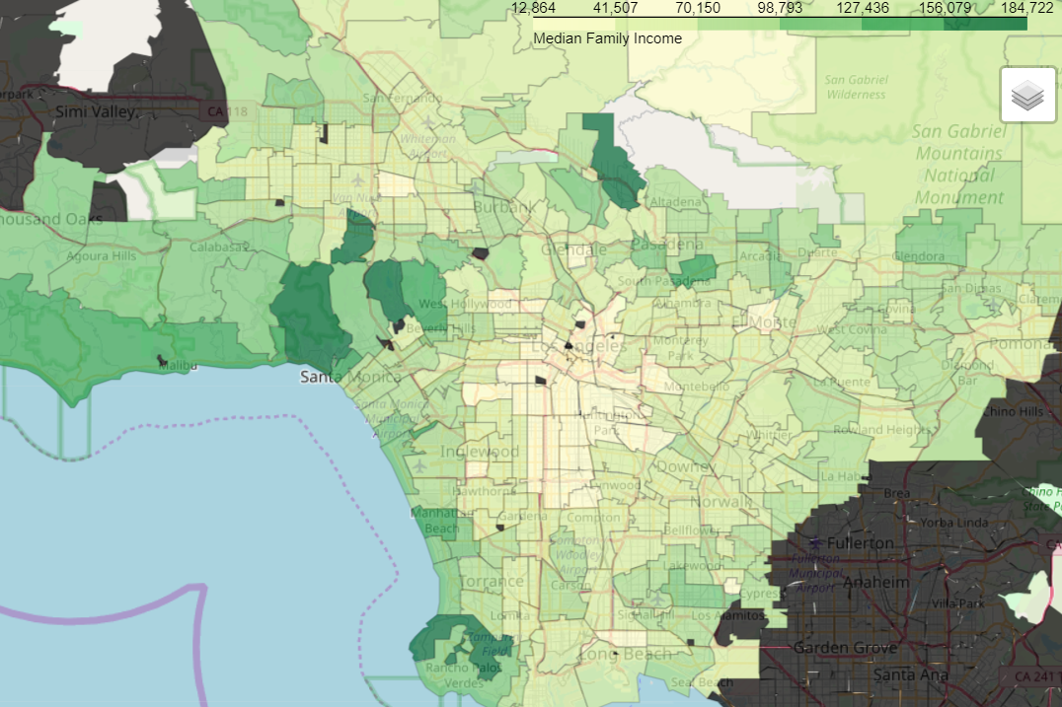
Maps of Los Angeles
Map of ZIP locations (left) and of median income values (right)

Slide 5
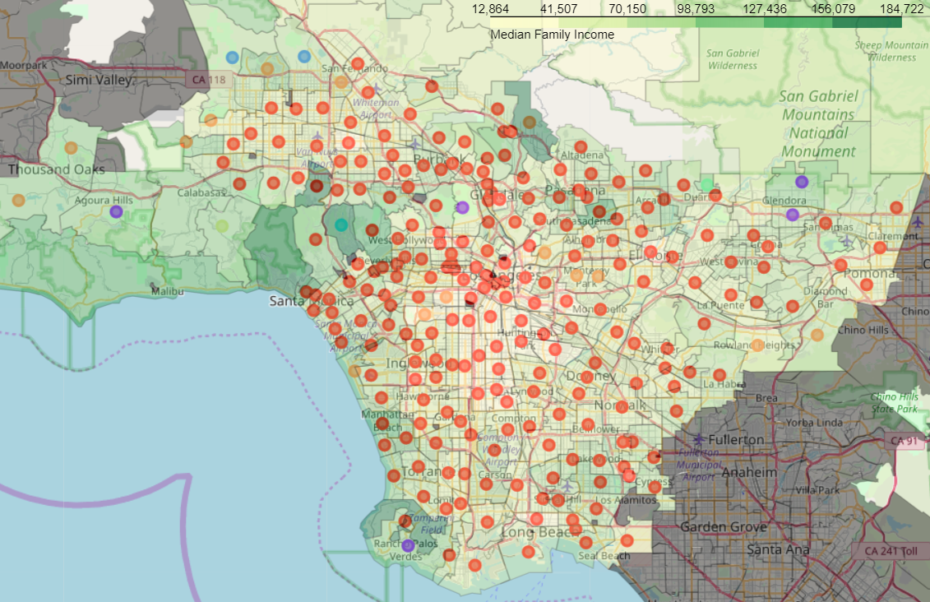
Combined Map with Clustering
Seven clusters
Size range 1-225
We want to remove clusters of size ~1

Slide 6
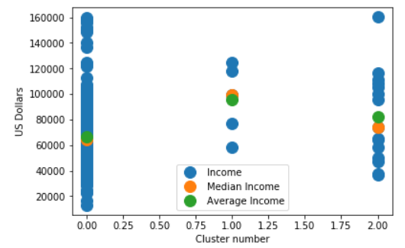
Income Ranges and Choosing Cluster
Choose cluster of medium size
Extract ZIPs with lower incomes for gentrification
Median and average of median income shows skewness to rich/poor

Slide 7
Results Table
ZIP | Neighborhood | Income | Distance (miles)
90008 | Los Angeles (Baldwin Hills, Crenshaw, Leimert Park) | 36641 | 6
90018 | Los Angeles (Jefferson Park, Leimert Park) | 37341 | 4
90032 | Los Angeles (El Sereno, Monterey Hills) | 47370 | 5
91755 | Monterey Park | 49755 | 7
91754 | Monterey Park | 58056 | 6
91304 | Los Angeles (Canoga Park, West Hills), Box Canyon | 64367 | 25
91748 | City of Industry, Rowland Heights | 64983 | 20
91345 | Los Angeles (Mission Hills) | 74193 | 20

Slide 8
Conclusion
Choose neighborhoods with small distance from downtown L.A.
Choose with lower median incomes for higher return
Consider population density only if core density or higher
Final recommendations for investing/protecting gentrification:
Leimert Park
El Sereno
Monterey Park

